Slide 1


Slide 2
TEXT SUMMARIZATION of URDU USING EXTRACTION BASE

Slide 3
GROUP MEMBERS
MUHAMMAD UZAIR MSDS20053
QAZI DANISH AYUB MSDS20075
HIRA SALEEM MSDS20104
AHMAD NAWAZ MSDS20093

Slide 4
INTRODUCTION
Automatic text summarization tool facilitate the user to understand the whole document in a short time of period. We have implemented some of the current state of the art algorithms and compare their performance for Urdu.

Slide 5
MOTIVATION
Automatic text summarization is an essential tool in this era of information overloading it can be used for :
Summaries in everyday life
Abridgment such as of books
Digest such as summary of stories
Biography such as resume, obituary
Abstract such a summary of a scientific paper
Condensed review of books, music, plays, etc.
Headlines such as summaries of newspaper articles
Table of contents such as summary of a book, magazine
Highlights such as summary of an event (meeting, sports event, etc.)

Slide 6
PROBLEM STATEMENT
Analyzing extraction based technique for Urdu text summarization using state of the art algorithms

Slide 7
RELATED LITERATURE
Analyzing Pre-processing Settings for Urdu Single-document Extractive Summarization
Muhammad Humayoun, Hwanjo Yu
Published :
IRIT ( Institut de Recherche en Informatique de Toulouse ), Universite Paul Sabatier, Toulouse, France

Slide 8
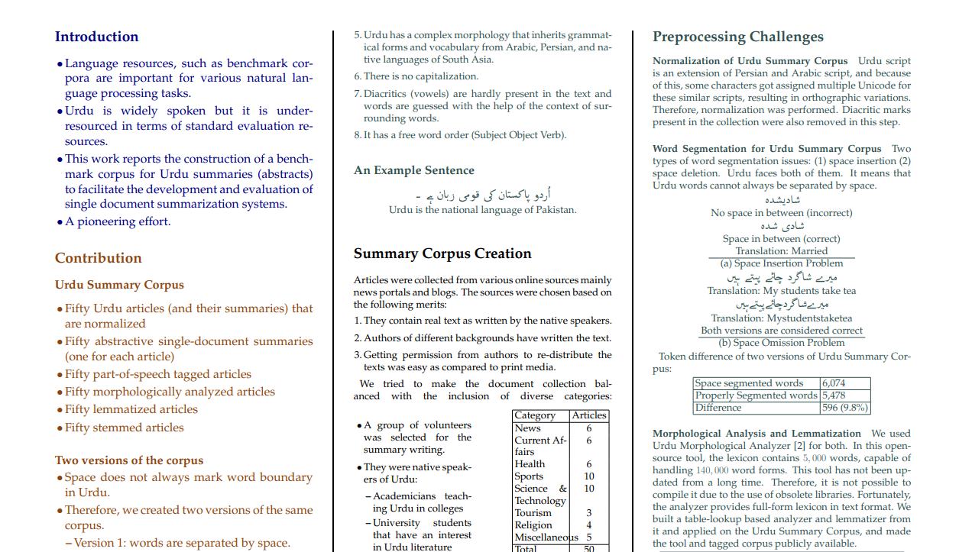
DATA SET URDU SUMMARY CORPUS

Slide 9
DATA SET PRE PROCESS STEP
According to paper by apply lemmatization and stemming, results does not improve on urdu language so we generate our results on different preprocess approaches.
Unsegmented (Not Proper Tokenize) + Stopword Removal
Unsegmented (Not Proper Tokenize) + Stopword Removal+Stemming
Segmented (Proper Tokenize) + Stopword Removal
Segmented (Proper Tokenize) + Stopword Removal+Stemming

Slide 10
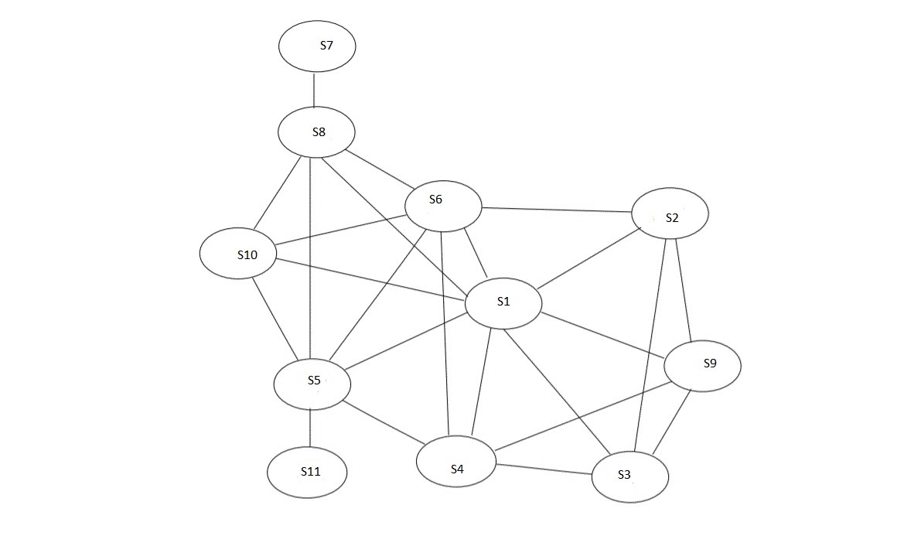
MEthodology
Lehn - heuristic method
Latent Semantic Analysis, LSA - one of the algorithm Using latent semantic and summary evaluation.
LexRank - Unsupervised approach inspired by algorithms PageRank and HITSce
TextRank - Unsupervised approach, also using PageRank algorithm, reference
SumBasic - Method that is often used as a baseline in the literature.

Slide 11
Evaluation measures & Results
The following five evaluation metrics are available.
ROUGE-1 refers to the overlap of unigram (each word) between the system and reference summaries.
ROUGE-2 refers to the overlap of bigrams between the system and reference summaries.
ROUGE-L: Longest Common Subsequence (LCS)based statistics. Longest common subsequence problem takes into account sentence level structure similarity naturally and identifies longest co-occurring in sequence n-grams automatically.
Recall: |system-human choice overlap| / |sentences chosen by human|
Precision: And precision is the fraction of system sentences that were correct Formula :|system-human choice overlap| / |sentences chosen by system|

Slide 12
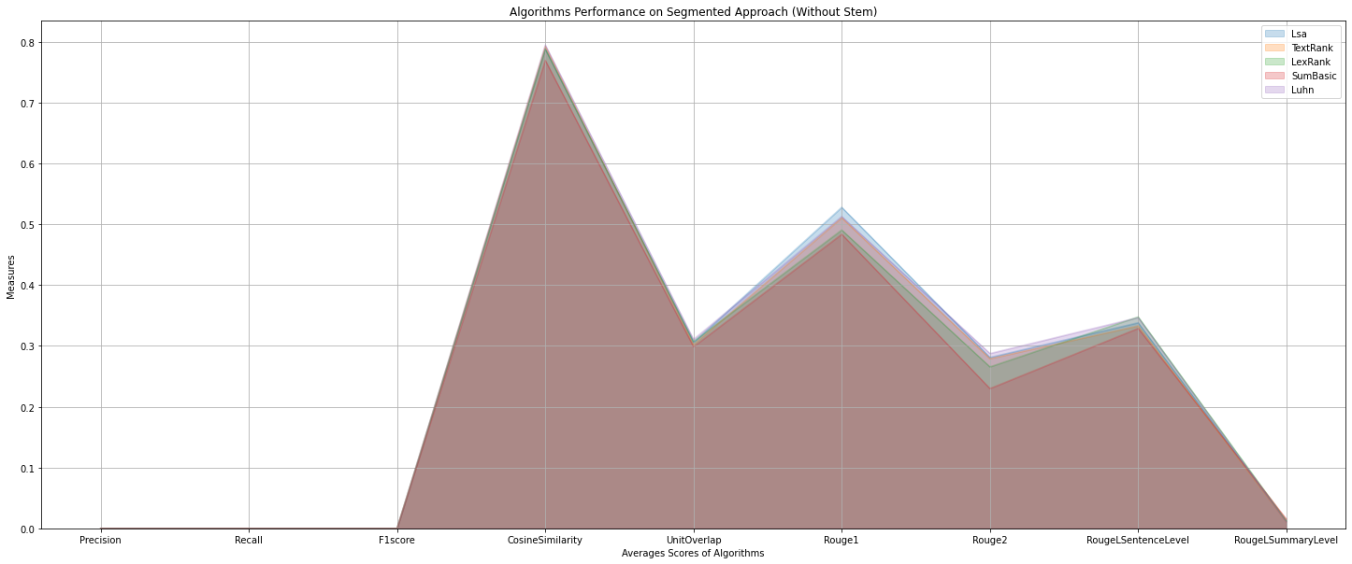
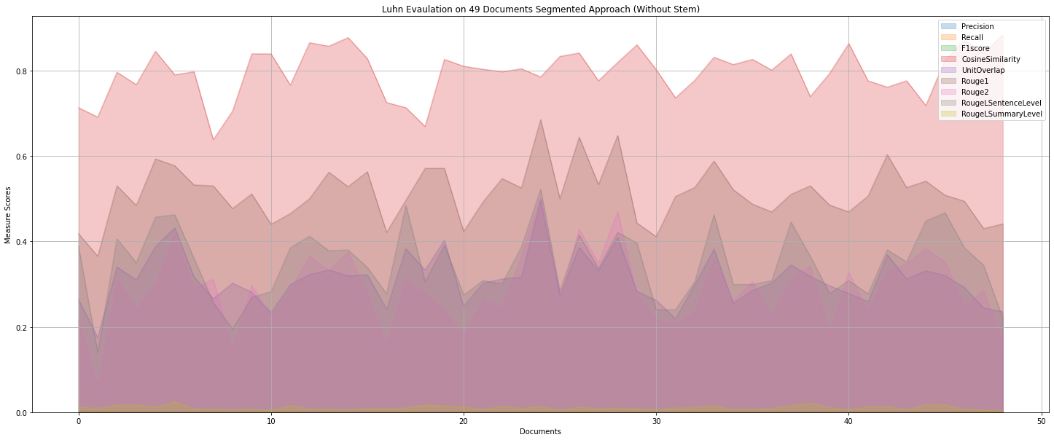
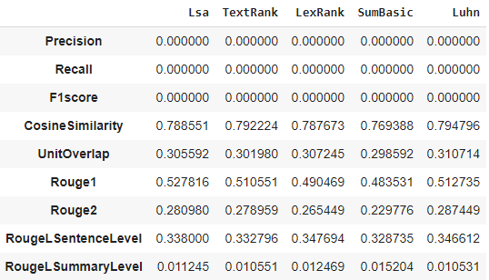
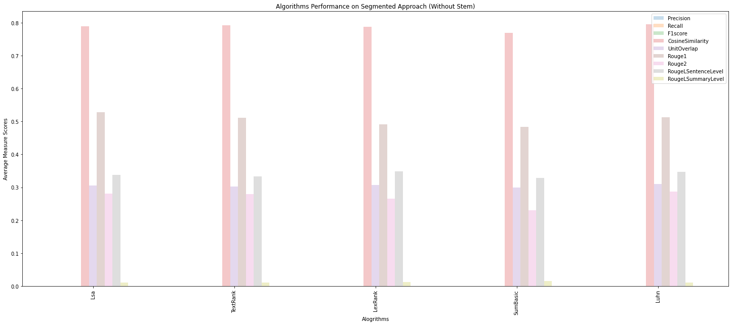

Slide 13
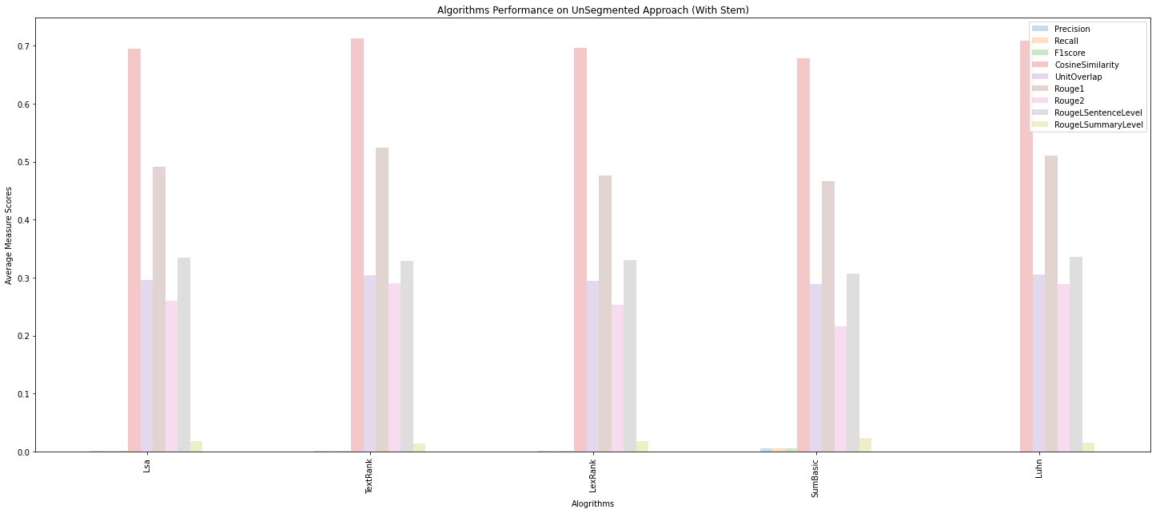



1
2
3
4

Slide 14
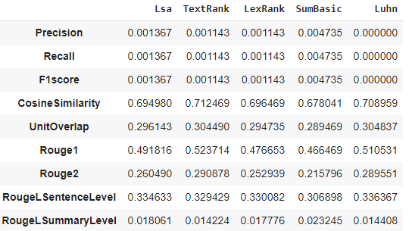
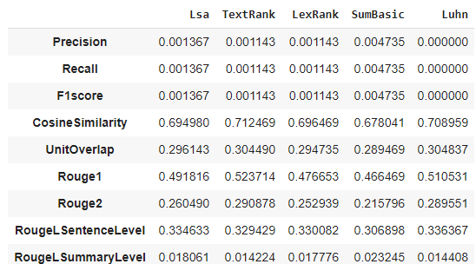
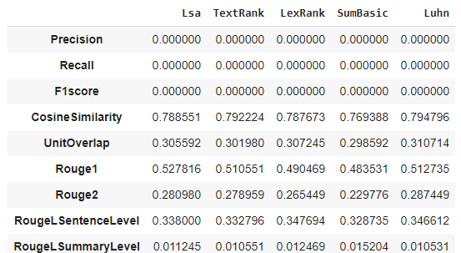
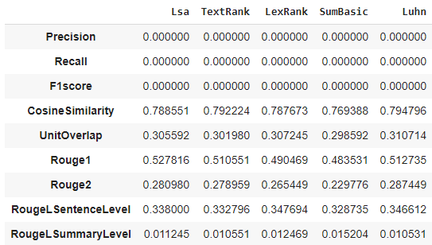
1
2
3
4

Slide 15
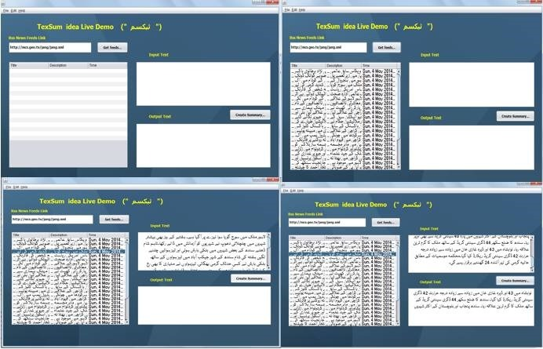
AVAILABLE_Algo = (
("Lsa", LsaSummarizer()),
("TextRank", TextRankSummarizer()),
("LexRank", LexRankSummarizer()),
("SumBasic", SumBasicSummarizer()),
("Luhn", LuhnSummarizer())
)
کراچی کے مختلف علاقوں میں فائرنگ اور دیگر پر تشدد واقعات کا نہ رکنے والا سلسلہ جاری ہے اور پیر کو 15 افراد کو موت کے گھاٹ اتار دیا گیا
کورنگی کے علاقے زمان ٹاوٴن میں نامعلوم افراد نے فائرنگ کرکے ایک شخص کو قتل کردیا
ملیر کے علاقے رفاہ عام سوسائٹی میں پارک کے نامعلوم افراد نے فائرنگ کرکے 2 افراد کو قتل کردیا
پولیس حکام کے مطابق مقتول کو ذاتی دشمنی پر عامر نامی شخص نے قتل کیا جو واردات کے بعد فرار ہو گیا
اورنگی ٹاون کی کالی پہاڑی کے قریب فائرنگ کر کے سیاسی جماعت سے تعلق رکھنے والے یاسین کو قتل جبکہ عدنان اور ماجد کوزخمی کر دیا گیا
ڈیفنس فیز 2 کی کچرا کنڈی ، پرانی سبزی منڈی پر واقع عسکری پارک اور اولڈ سٹی ایریا سے 3 افراد کی تشددزہ لاشیں بھی ملی ہیں
for name, algo in AVAILABLE_Algo:
df_non_seg=GenerateSummaryAndEvaulationSum(df_non_seg,'NonSegmentedData','NonSegmentedSum',algo,name,1,"۔")
df_non_seg_stem=GenerateSummaryAndEvaulationSum(df_non_seg,'NonSegmentedStem','NonSegmentedSum',algo,name,1,"۔")
df_seg=GenerateSummaryAndEvaulationSum(df_seg,'SegmentedData','SegmentedSum',algo,name,2,"۔")
df_seg_stem=GenerateSummaryAndEvaulationSum(df_seg,'SegmentedStem','SegmentedSum',algo,name,2,"۔")

Slide 16
ConClusion
With or Without Stemming and StopWord Removal Results does not change (We observe similar as mention in paper).
Proper Segmentation Produce better results on urdu data(We observe similar as mention in paper).
Luhn(1) & TextRank(2) Algorithm have Good Results as compared to other’s.
Cosine Similarity,Rouge 1,2 ,L & Unit OverLapping are Good Evaluation measures as Compare to F1,Recall and Precision
Unit Overlapping = Rouge L Sentence Level + Rouge L Sentence Level

Slide 17
References
https://www.cis.upenn.edu/~nenkova/papers/ipm.pdf
https://ieeexplore.ieee.org/document/5392672?arnumber=5392672
https://www.aclweb.org/anthology/L16-1585.pdf
https://www.aclweb.org/anthology/L16-1128.pdf
https://pypi.org/project/sumy
https://github.com/humsha/USCorpus

Slide 18



